Slide 1
FAA–India UAS Meeting under Aviation Cooperation Program
Joseph Morra, Director
Safety & Integration Division, AUS-400
August 24, 2021

Slide 2
Small UAS Rule (14 CFR Part 107)
First rule for small UAS
(<55 pounds)
Commercial, hobby, governmental operators can operate under Part 107
Became effective August 29, 2016
Recent Part 107 amendment will permit routine operations
  over people
  over moving vehicles
  at night under certain conditions

Slide 3
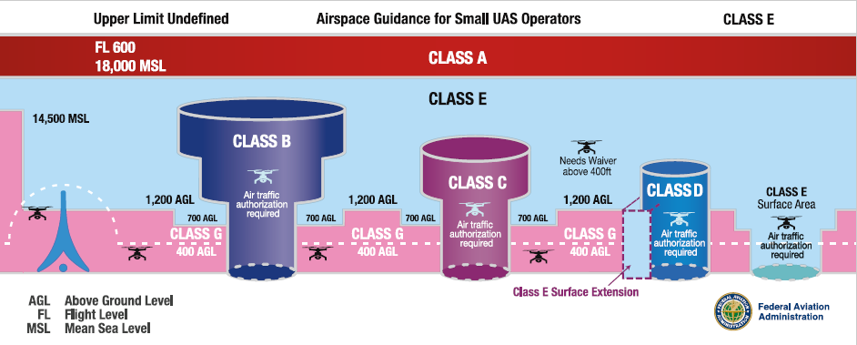
Part 107 Airspace Requirements
Operations in Class G and Class E non-surface do not require ATC authorization
Operations in Class B, C, D & Class E surface areas require ATC authorization
Online portal available at the FAA DroneZone and through LAANC

Slide 4
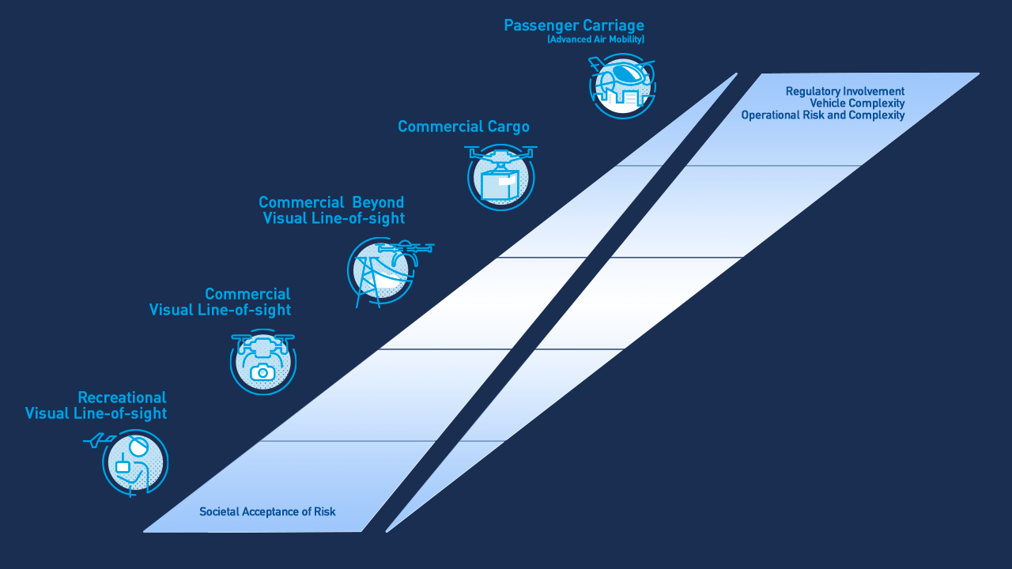

Slide 5
Remote Identification (ID) Overview
Remote identification is a “digital license plate” technology for unmanned aircraft (UA) where information is broadcast directly from the UA to nearby receivers
Final rule published in Federal Register on Jan 15, 2021
Important dates:
  Rule effective date: April 21, 2021
  Production compliance date: September 16, 2022
  Operational compliance date: September 16, 2023

Slide 6
Operations Over People Overview
Small UAS Operations over People NPRM published February 13, 2019
  Approximately 933 comments received at close of comment period, April 15, 2019
Final rule published on January 15
Rule effective on April 21, 2021:
  Creates categories of operations that permit small UAS to operate over people
  Allows small UAS operations over moving vehicles
  Allows routine night operations
  Updates initial testing and recurrent training requirements

Slide 7
From IPP to BEYOND
Challenge
Enable BVLOS operations that are repeatable, scalable, and economically viable, and
address community feedback to realize societal and economic benefits
Principles
  Focus on addressing the challenges of integrating BVLOS UAS operations into the NAS.
  Improve internal processes to ensure consistency and repeatability of UAS operational approvals.
  Develop a strategy to transition UAS to operations by rule, and inform specific rule areas.
  Enable the UAS commercial industry to leverage operations to better document the societal and economic benefits of UAS technology.
  Provide an opportunity to address state and local government concerns regarding UAS integration.

Slide 8

So, what is LAANC?
LAANC is the Low Altitude Authorization and Notification Capability, a collaboration between FAA and Industry. It directly supports UAS integration into the airspace.
LAANC provides:
  Drone pilots with access to controlled airspace at or below 400 feet.
  Awareness of where pilots can and cannot fly.
  Air Traffic Professionals with visibility into where and when drones are operating.
  Through the UAS Data Exchange, the capability facilitates the sharing of airspace data between the FAA and companies approved by the FAA to provide LAANC services. The companies are known as UAS Service Suppliers — and the desktop applications and mobile apps to utilize the LAANC capability are provided by the UAS Service Suppliers (USS).

Slide 9
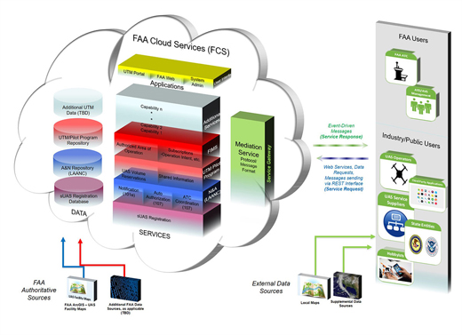
UAS Traffic Management (UTM)

Slide 10
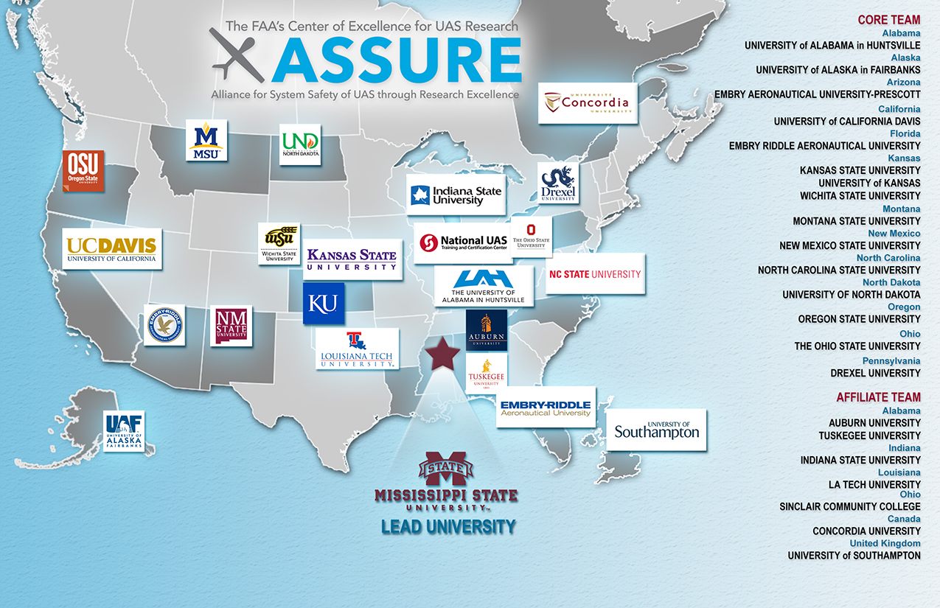
UAS Research and Advanced Aviation

Slide 11
BVLOS ARC Tasks
Identify safety and environmental considerations for BVLOS UAS operations, accounting for the security needs of the U.S. Government
Identify societal benefits for BVLOS UAS operations
Recommend requirements and provide rationale to enable BVLOS operations

