Slide 1
FAA–India UAS Meeting under Aviation Cooperation Program
Bruce DeCleene, Director
FAA Office of Safety Standards
August 24, 2021

Slide 2
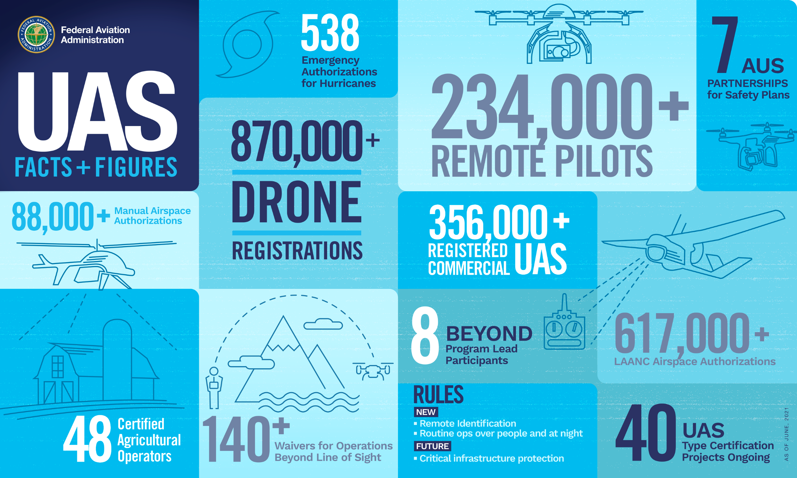

Slide 3
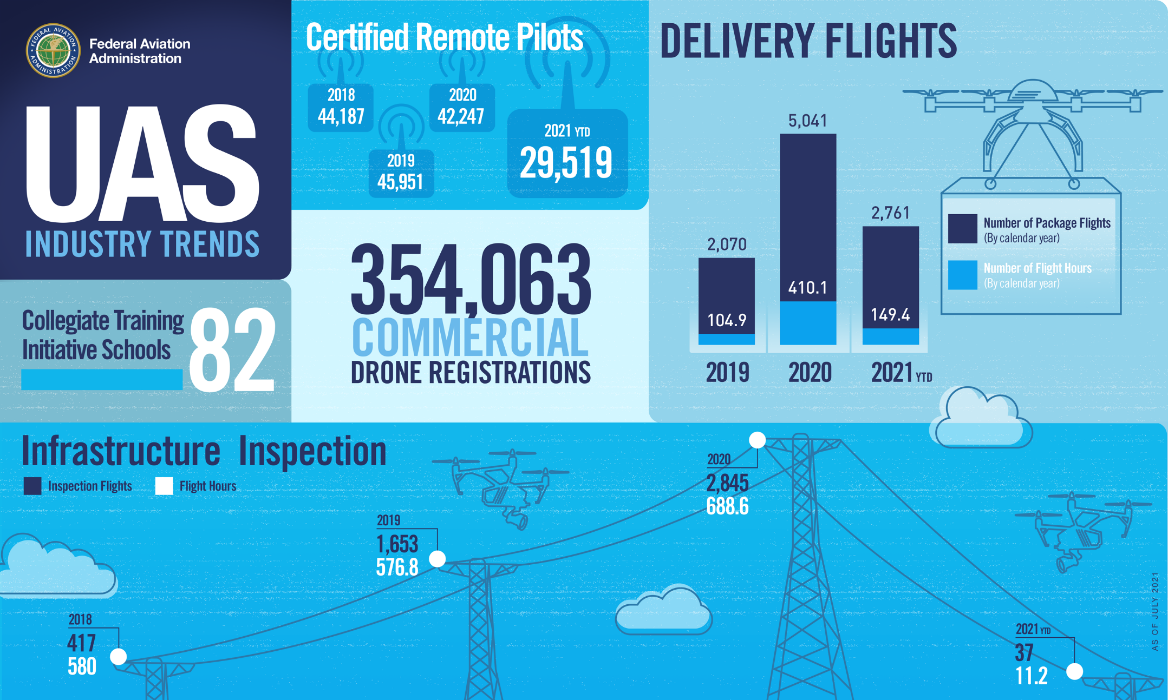

Slide 4
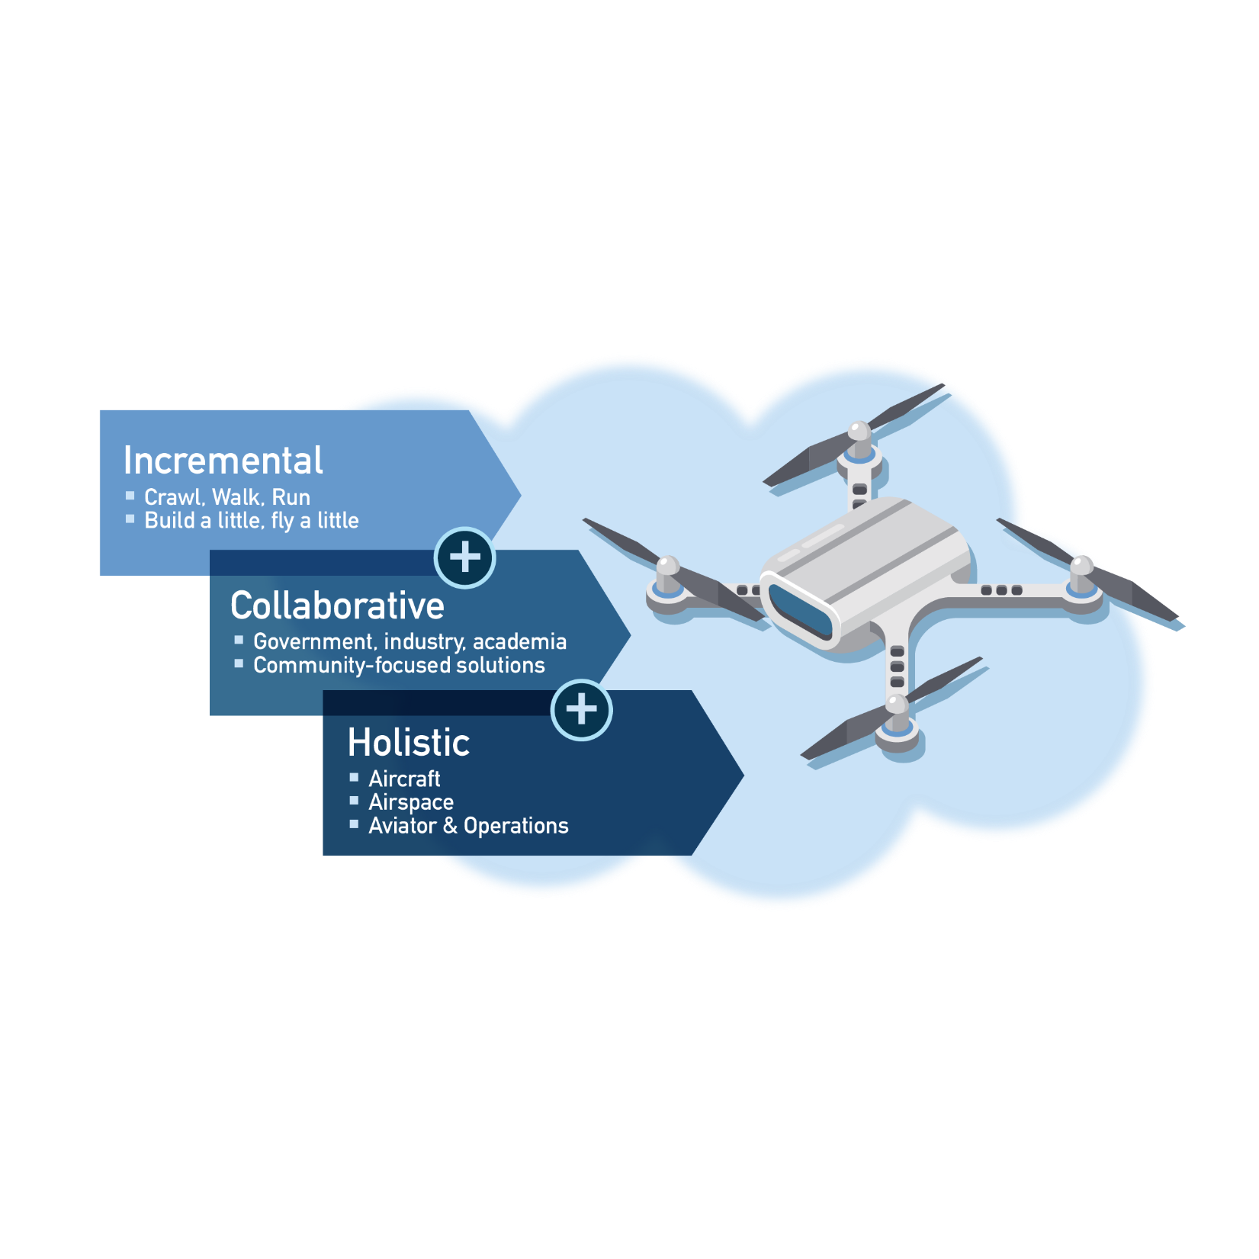
UAS Integration Approach

Slide 5
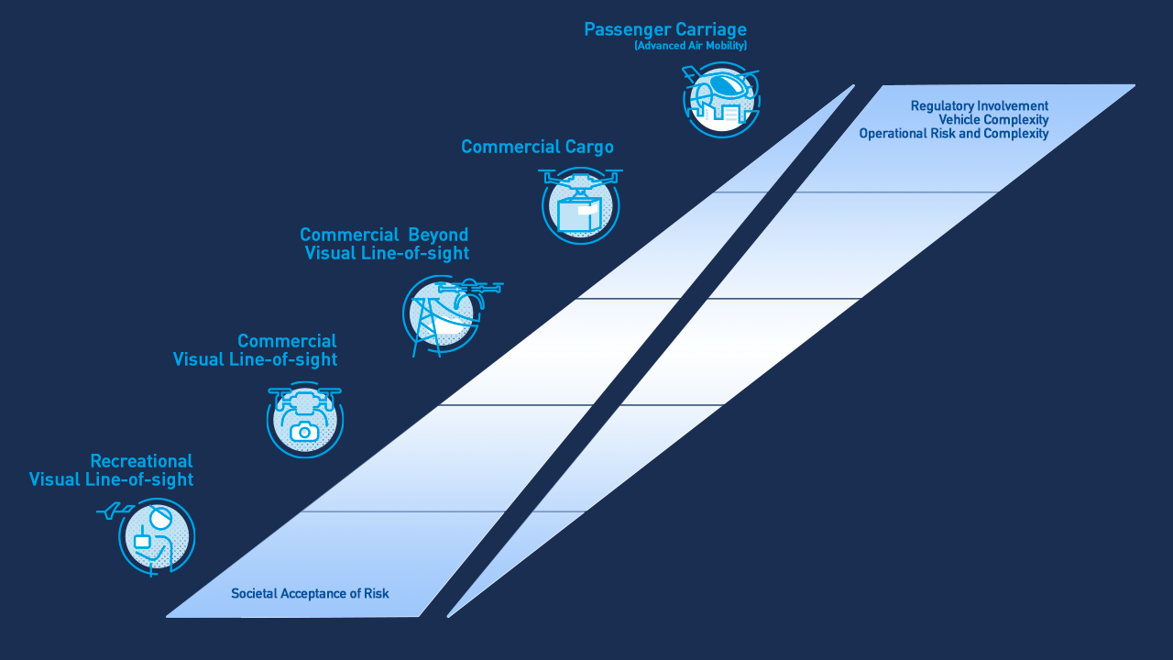

Slide 6
Risk Mitigation
1
2
3
4
Prevention
Registration
Education & Outreach
Airspace Restrictions
Pilot Training & Certification
Deterrence
Law Enforcement (LE) Support
Incident Reporting
Enforcement
Detection
Remote Identification
UAS Detection Systems
Response
LE Response
UAS Mitigation Systems

Slide 7
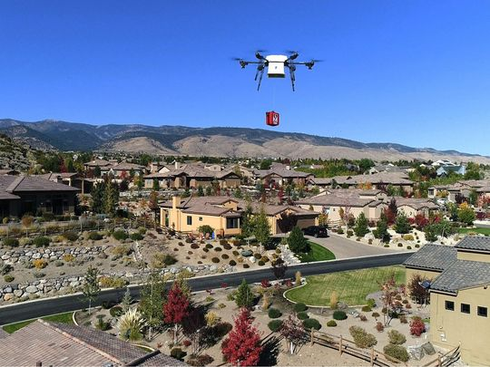
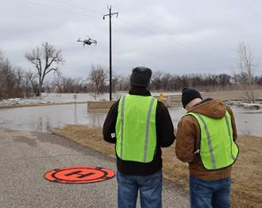
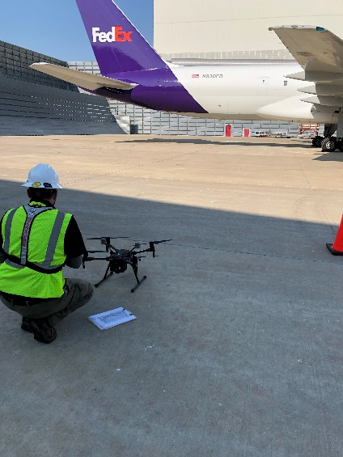
Public-Private Partnerships
  Low Altitude Authorization and Notification Capability (LAANC)
  UAS Integrated Pilot Program (IPP)
  BEYOND
  Partnerships for Safety Plans Program
  UTM Partnership Program
  UAS Safety Team
  Drone Advisory Committee
  FAA UAS Symposium, Episode IV, September 14-15, 2021

Slide 8

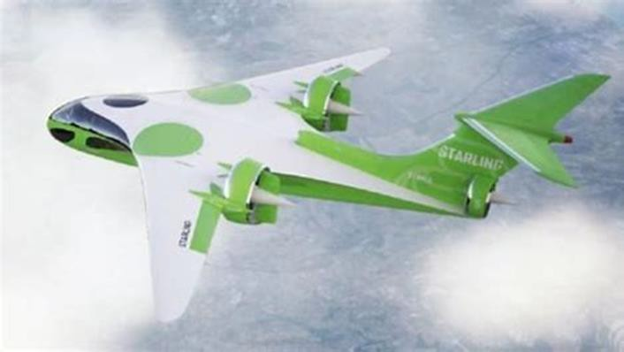
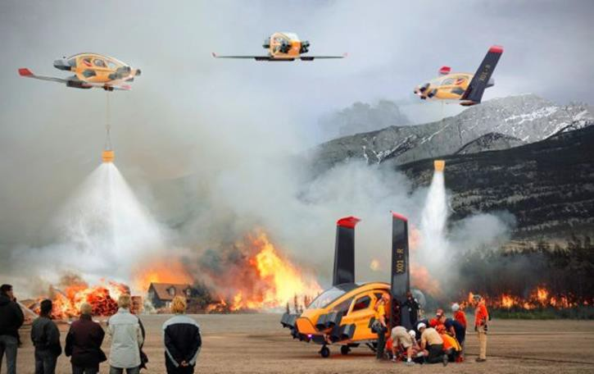

Advanced Aerial Mobility (AAM)
Includes use cases not specific to operations in
urban environments
  Commercial Inter-city (Longer Range/Thin Haul)
  Cargo Delivery
  Public Services
  Private / Recreational Vehicles
AAM concepts possess common characteristics
  Similar technologies (automation,
  electrified/hybrid vehicles)
  UTM-inspired Air Traffic Management (ATM) systems
  Many of the same challenges

Slide 9
International Partnerships & Harmonization
UAS Integration is a GLOBAL Challenge
Currently working with several international organizations, including:
  International Civil Aviation Organization (ICAO)
  Joint Authorities for Rulemaking on Unmanned Systems (JARUS)
  Radio Technical Commission for Aeronautics (RTCA) & European Organization for Civil Aviation Equipment (EUROCAE)
  American Society for Testing and Materials (ASTM) International
  American National Standards Institute (ANSI)/International Organization for Standardization (ISO)
  Civil Air Navigation Services Organization (CANSO)

