Slide 1
SEPARATE PROCEDURES AND ROUTES FOR GENERAL AVIATION
DIRECTORATE OF AIR TRAFFIC MANAGEMENT
A K Jain, GM (ATM)

Slide 2
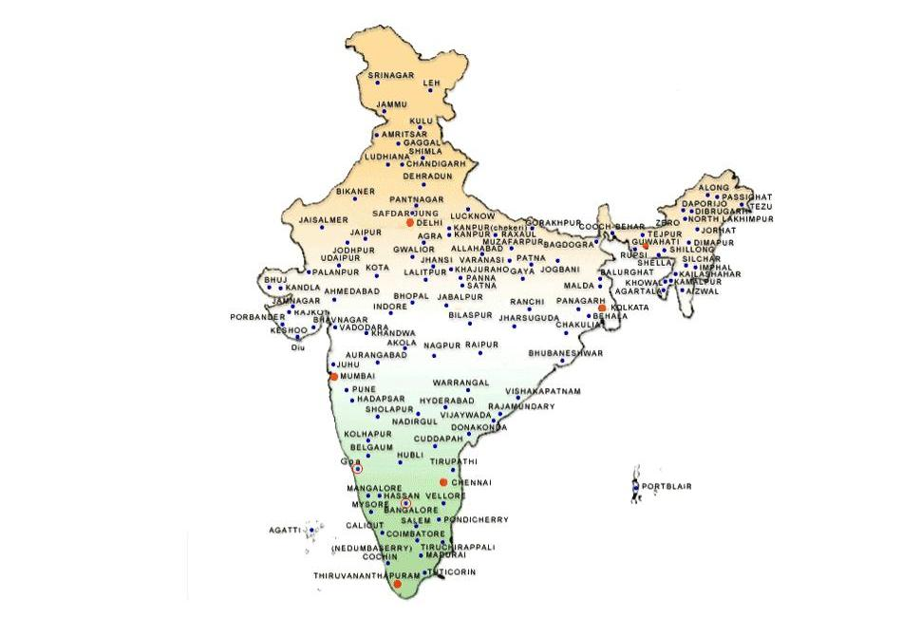
AAI manages - 126 airports
14 International Airports
[ 8 AAI & 6 JV]
9 Custom Airports
[7 AAI & 2 CE]
85 Domestic Airports
26 Civil Enclaves
[CNS/ATM Services at 6 airports]
[Delhi, Mumbai, Hyderabad, Bangalore Nagpur and Cochin airport]

Slide 3
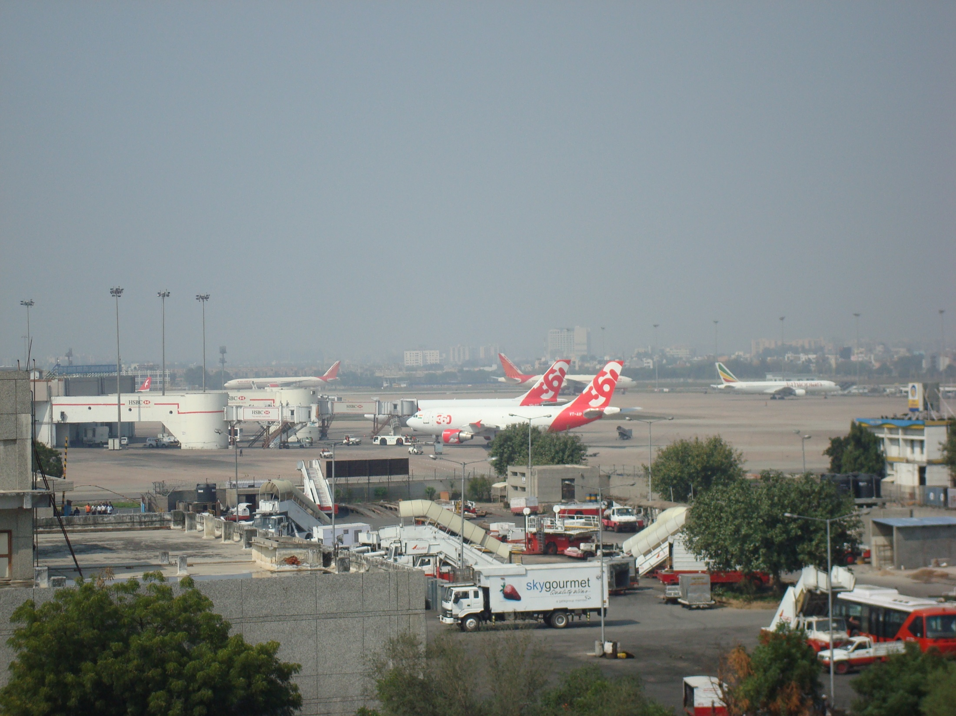
AIRPORT CLASSIFCATION
Number of movements Airport
More than 500 2 (Delhi and Mumbai)
200-500 4 (Chennai, Kolkata, Hyderabad
and Bangalore)
75- 200 6
less than 75 24
less than 20 90

Slide 4
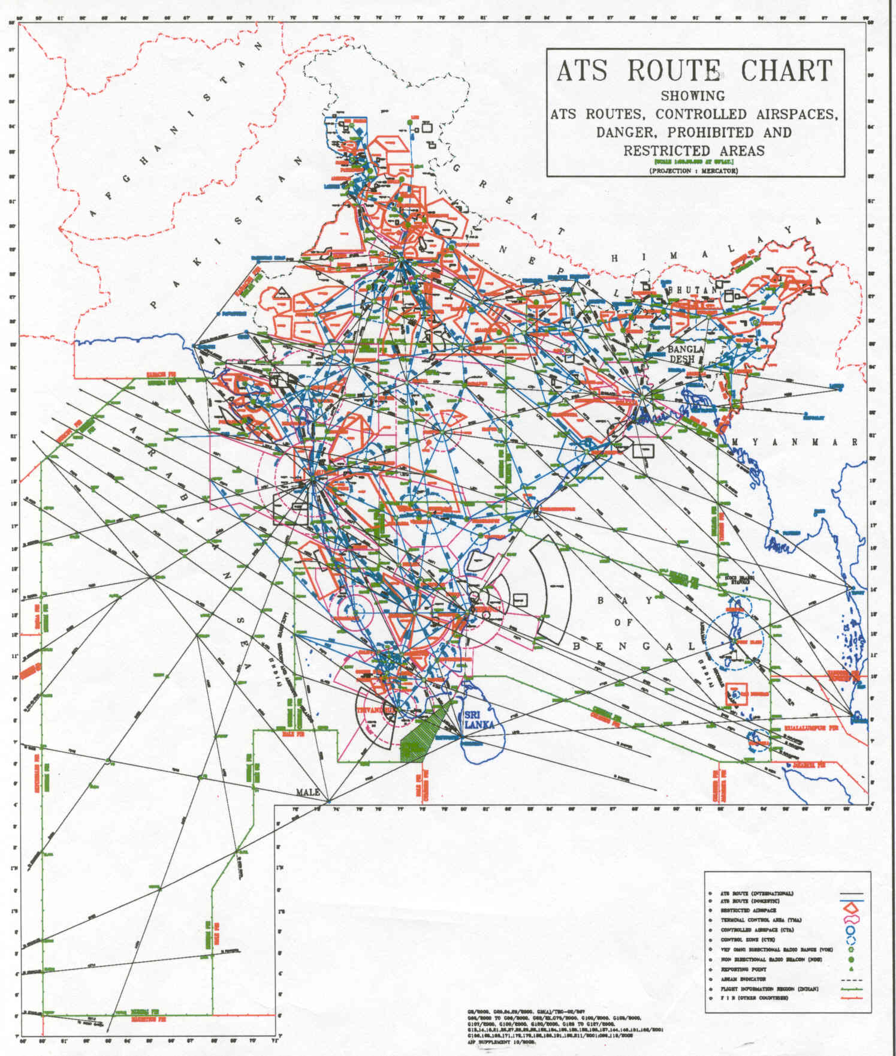
TOTAL AIRPSACE - 2. 8 M SQ NM OCEANIC AIRSPACE - 1.7 M SQ NM CONTINENTAL AIRSPACE – 1.1 M SQ NM

Slide 5
The 5 FIRs
AIRSPACE IS DIVIDED IN 4 FIRs (MUMBAI, KOLKATA , DELHI AND CHENNAI
& GUWAHATI AS SUB FIR
AND 5 ADIZ ( NORTH, WEST, CENTRAL, EAST, SOUTH AND SOUTH-EAST SUB ADIZ)
TWELVE NEIGHBOURING STATES SURROUND INDIAN AIRSPACE
[Pakistan, Oman, Saana, Mogadishu, Seychelles, Mauritious, Male, Srilanka, Malaysia, Myanmar, Bangladesh, Nepal ]
1
5
4
3
2
Graph Not to Scale

Slide 6
Airspace Management ……
Total ATS routes = 244
International ATS routes - 88 [Including 34 RNP10 routes]
Domestic ATS routes – 124
Conditional /Connecting ATS routes - 32
Helicopter routes are not included
Entire airspace over high seas is exclusive RVSM airspace and
Continental airspace as Non exclusive RVSM airspace.

Slide 7
General Aviation
Private aircraft
Aircraft owned by companies
Flying club aircraft
Small taxi operators
Helicopters

Slide 8
No separate procedures for General Aviation aircraft except for helicopter routings at Delhi, Mumbai and Bangalore airport.
No restriction on movement of General Aviation aircraft from ATM point of view except restriction at Mumbai airport during peak hours.
- All arrival and departure procedures are based on category of aircraft which is based on aircraft speed on final approach as per ICAO criteria.

Slide 9
Exceptions
General Aviation aircraft are normally parked on remote parking to facilitate the movement of Schedule aircraft .
Aerodrome Operating Minima for General Aviation aircraft is higher ( Restricted Minima as define by DGCA). aft

Slide 10
AAI UPCOMING INITIATIVES
- Air Traffic Flow Management ( Dec 2012)
- PBN SIDs and STARs at all major airports
- Automation of ATC system at 38 Airports ( June 2012)
- Satellite Based Augmentation System (SBAS) – GAGAN
( June 2013)
- Clearance Delivery through Data Link
- Integration of Radars
- ADS(B) at 14 locations to cover Radar Gaps.
- RNAV 5 routes, First route will be between Delhi and Mumbai.
- Merging of Area Control Centers and Harmonization of Upper air space

Slide 12
General Aviation Operators
To upgrade their aircraft equipage
To train pilots
Get approval to fly RNAV procedures / routes.
to take full advantage of AAI initiatives.

Slide 13
Thank you for your attention

